Slide 1
Database Management Systems
By:
Dr. Neha Nandal
Computer Science and Engineering

Slide 2
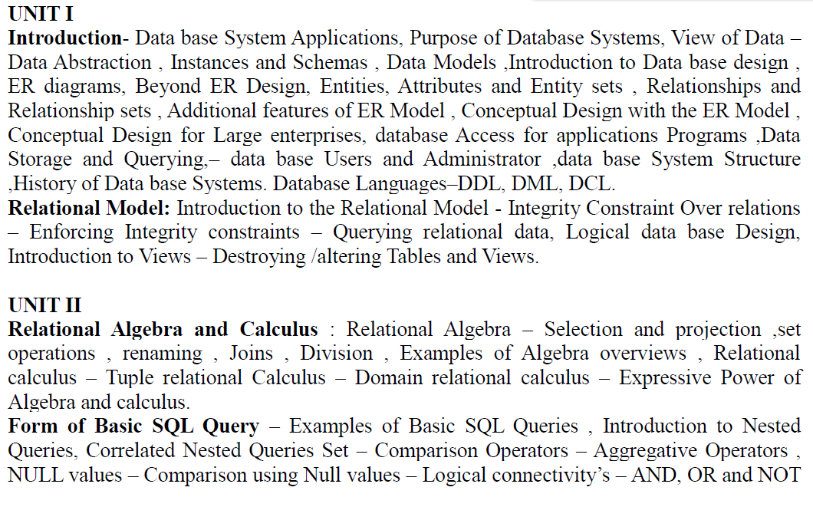
DATABASE MANAGEMENT SYSTEMS

Slide 3
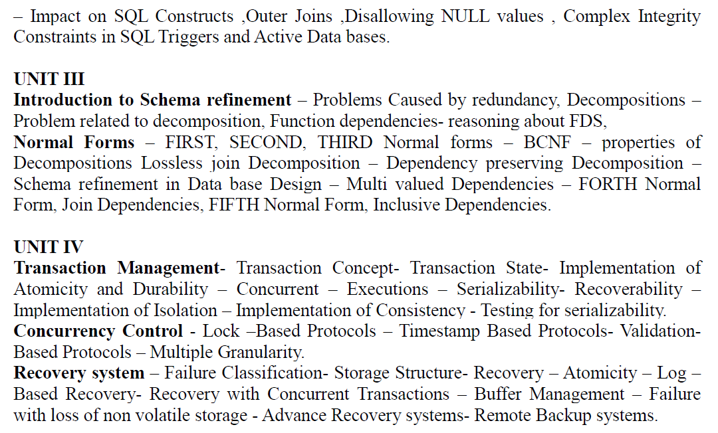
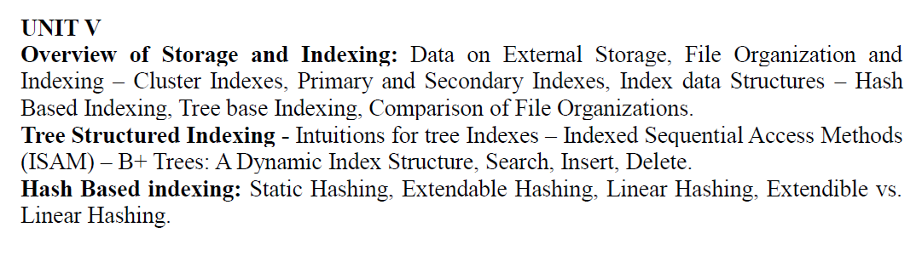

Slide 4
TEXT BOOKS:
1. Data base System Concepts, Silberschatz, Korth, McGraw hill, Sixth Edition.(All UNITS except III th)
2. Data base Management Systems, Raghurama Krishnan, Johannes Gehrke, TATA McGrawHill 3rd Edition.

Slide 5
Unit 3:
SCHEMA REFINEMENT
The Schema Refinement refers to refine the schema by using some technique. The best technique of schema refinement is decomposition.
Normalization means “split the tables into small tables which will contain less number of attributes in such a way that table design must not contain any problem of inserting, deleting, updating anomalies and guarantees no redundancy”.
Normalization or Schema Refinement is a technique of organizing the data in the database. It is a systematic approach of decomposing tables to eliminate data redundancy and undesirable characteristics like Insertion, Update and Deletion Anomalies.

Slide 6
Redundancy: refers to repetition of same data or duplicate copies of same data stored in different locations.
Anomalies: Anomalies refers to the problems occurred after poorly planned and normalized databases where all the data is stored in one table which is sometimes called a flat file database.

Slide 7
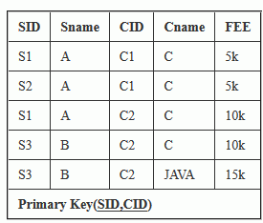
Anomalies or problems facing without normalization (problems due to redundancy):
Anomalies refers to the problems occurred after poorly planned and unnormalized databases where all the data is stored in one table which is sometimes called a flat file database.
Let us consider such type of schema

Slide 8
Due to redundancy of data we may get the following problems, those are-
insertion anomalies : It may not be possible to store some information unless some other information is stored as well.
2. redundant storage: some information is stored repeatedly
3. update anomalies: If one copy of redundant data is updated, then inconsistency is created unless all redundant copies of data are updated.
4. deletion anomalies: It may not be possible to delete some information without losing some other information as well.

Slide 9
Problem in updation / updation anomaly – If there is updation in the fee from 5000 to 7000, then we have to update FEE column in all the rows, else data will become inconsistent.

Slide 10
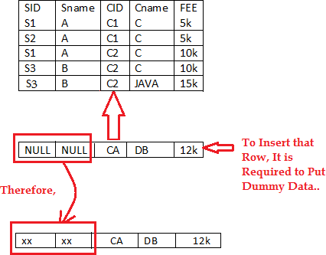
Insertion Anomalies: New course is introduced C4, But no student is there who is having C4 subject.

Slide 11
Deletion Anomaly:
Deletion of S3 student cause the deletion of course. Because of deletion of some data forced to delete some other useful data.

Slide 12
Solutions To Anomalies : Decomposition of Tables – Schema Refinement, shown below.

Slide 13
Purpose of Normalization:
➢ Minimize the redundancy in data.
➢ Remove insert, update, and delete anomalies during the database activities.
➢ Reduce the need to organize the data when it is modified or enhanced.
➢ Normalization reduces a complex user view to a set of small and sub groups of fields or relations. This process helps to design a logical data model known as conceptual data model.

Slide 14
Advantages of Normalization:
1. Greater overall database organization will be gained.
2. The amount of unnecessary redundant data reduced.
3. Data integrity is easily maintained within the database.
4. The database & application design processes are much for flexible.
5. Security is easier to maintain or manage.
Disadvantages of Normalization:
1. The disadvantage of normalization is that it produces a lot of tables with a relatively small number of columns. These columns then have to be joined using their primary/foreign key relationship.
2. This has two disadvantages.
Performance: all the joins required to merge data slow processing & place additional stress on your hardware.
Complex queries: developers have to code complex queries in order to merge data from different tables.

Slide 15
Concept of Functional Dependency:
Functional Dependencies are fundamental to the process of Normalization i.e., Functional Dependency plays key role in differentiating good database design from bad database designs. A functional dependency is a “type of constraint that is a generalization of the notation of the key”.

Slide 16
Reasoning about functional dependencies:
Armstrong Axioms (Inference Rules ) :
The term Armstrong axioms refers to the sound and complete set of inference rules or axioms, introduced by William W. Armstrong, that is used to test logical implication of functional dependencies.
Armstrong axioms define the set of rules for reasoning about functional dependencies and also to infer all the functional dependencies on a relational database.

Slide 17
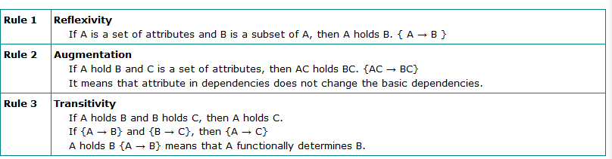
Various axioms rules or inference rules:
Primary axioms:

Slide 18
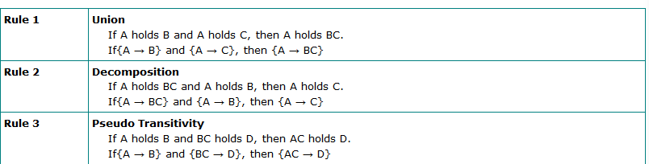
Secondary or derived axioms:

Slide 19
Closure of a Set of Attributes:
Attribute closure of an attribute set can be defined as set of attributes which can be functionally determined from it.
The set of FD’s that is logically implied by F is called the closure of F and written as F+. And it is defined as “If F is a set FD’s on a relation R, the F+, the closure of F by using the inferences axioms that are not contained in F+.
Example: R (A, B, C, D) and set of Functional Dependencies are A→B, B→D, C→B then what is the Closure of A, B, C, D?
Solution: A+ is
A+→ {A, B, D} i.e., A→B, B→D is exists and C is not FD on A. So it is eliminated. B+→ { B, D} i.e., B→D is exists and A, C is not FD on A. So it is eliminated.
C+→ {C, B, D} i.e., C→B, B→D is exists and A is not FD on C. So it is eliminated.

Slide 20
The algorithm for computing the attribute closure of a set X of attributes is shown below

Slide 21
Types of functional dependencies:
1. Fully Functional Dependency: A functional dependency is said to be full dependency “if and only if the determinant of the functional dependency if either candidate key or super key, and the dependent can be either prime or non-prime attribute”.
(OR)
Let’s take the functional dependency X → Y (i.e., X determines y). Here Y is said to be fully determinant, if it cannot determine any subset of X.
Example: Consider the following determinant ABC → D i.e., ABC determines D but D is not determined by any subset of A/ BC/C/B/AB i.e., BC→D, C→D, A→D Functional dependencies are not exists. So D is Fully Functional Dependent.
2. Partial Functional Dependency: If a non-prime attribute of the relation is getting derived by only a part of the candidate key, then such dependency is known as Partial Dependency.

Slide 22
(OR)
In a relation having more than one key field, a subset of non key fields may depend on all key fields but another subset or a particular non-key field may depend on only one of the key fields. Such dependency is defined as Partial Dependency.
Example: Consider the following determinants AC→P, A→D, D→P. From these determinants P is not fully FD on AC. Because, If we find A+ (means A’s Closure) A→D, D→P i.e., A→P. But we don’t have any requirement of C. C attribute is removed completely. So P is Partially Dependent on AC.
Under the following conditions a table cannot have partial F.D
(1) If primary key consists a single attribute
(2) If table consists only two attributes
(3) If all the attributes in the table are part of the primary key

Slide 23
3. Transitive Functional Dependency: If a non-prime attribute of a relation is getting derived by either another non-prime attribute or the combination of the part of the candidate key along with non-prime attribute, then such dependency is defined as Transitive dependency. i.e., in a relation, there may be dependency among non-key fields. Such dependency is called Transitive Functional Dependency. (1) If table consists only two attributes
(2) If all the attributes in the table are part of the primary key.
Example: X→Y, and Y→Z then we can determine X→Z holds.
Under the following Circumstances, a table cannot have transitive F.D
4. Trivial Functional Dependency: It is basically related to Reflexive rule. i.e., if X is a set of attributes, and Y is subset of X then X→Y holds.
Example: ABC→BC is a Trivial Dependency.

Slide 24
5. Multi-Valued Dependency: Consider 3 fields X, Y, and Z in a relation. If for each value of X, there is a well-defined set of values Y and Well-defined set of values of Z and set of values of Y is independent of the set values of Z. This dependency is Multi-valued Dependency. i.e., X →Y / Z.
Prime and non-prime attributes
Attributes which are parts of any candidate key of relation are called as prime attribute, others are non-prime attributes.
Candidate Key:
Candidate Key is minimal set of attributes of a relation which can be used to identify a tuple uniquely.
Consider student table: student(sno, sname,sphone,age)
we can take sno as candidate key. we can have more than 1 candidate key in a table. types of candidate keys:
1. simple(having only one attribute)
2. composite(having multiple attributes as candidate key)

Slide 25
Super Key:
Super Key is set of attributes of a relation which can be used to identify a tuple uniquely.
we can take sno, (sno, sname) as super key
➢ Adding zero or more attributes to candidate key generates super key.
➢ A candidate key is a super key but vice versa is not true. Consider student table: student(sno, sname,sphone,age)

Slide 26
Operations performed functional dependencies (applications of closure set of attributes):
To identify the additional F.D’s.
(2) To identify the keys.
(3) To identify the equivalences of the F.D’s
(4) To identify irreducible set (minimal set) of F.D’s or canonical forms of F.D’s or standard form of F.D’s.

Slide 27
1. In a schema with attributes A,B,C,D and E the following set of attributes are given A→B, A→C, CD→E, B→D, E→A. Find CD→AC determines from the given FDs or not.
Given FD is CD→AC find the closure set of CD.
CD+ = CDE (∵ CD→ E)
= CDEA (∵ E→ A)
= CDEAB (∵ A→ B)
From the closure set the attributes AC are determined by CD so CD→ AC.

Slide 28
(2) Identification of key by using closure set as attributes:
A key attribute:
An attribute that is capable of identifying all other attributes in a given table.
Primary key: It is an unique value attribute in a table to enforce entity integrity and ti identify rows in the table uniquely.
(ii) Composite Primary Key: Sometimes single attribute is not sufficient to identify uniquely the rows in the table so, we combine 2 or more attributes to identify the rows uniquely.
(iii) Candidate keys: Sometimes 2 or more independent attribute or attributes can be used to identify the rows uniquely Eg :( vech no,veng no,purchase date) Either vehicle no or vehicle engine no can be used as a key attribute then they are called as candidate keys one of the candidate key can be elected as primary key.

Slide 29
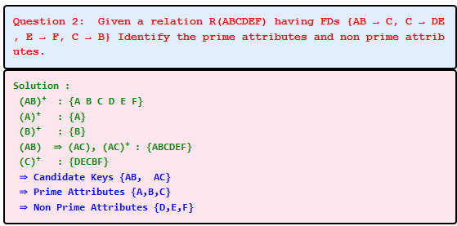

Slide 30
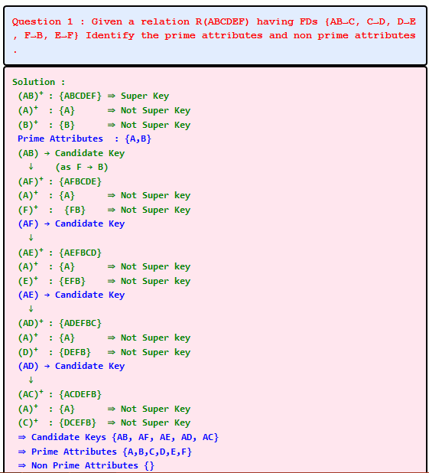

Slide 31
(3) To identify equivalence of F.D’s :
Different database designers may define different F.D’s sets from the same requirements. To evaluate whether they are equivalent if we are able to derive all F.D’s in G from F and vice- versa.

Slide 32
Step 1: Take set F and enclose all FD’s in G that can be derived from F. A→CD
A+ from F
=A
=AC (∵ A→ C)
=ACD (∵ AC→ D)
A → CD can be derived from F
E→AH
E+ from F
=E
=EAD
=EADH
 E → AH can be derived from F

Slide 33
Step 2: Take set G and enclose all F.D’s in F that can be derived from
G. A→C A+ from G
=A
=ACD
A → C can be derived from G
E →AD
E+ from G
=E
=EAH
=EAHCD
E → AH & E → AD can be derived from G
G and F are equivalent.

Slide 34
(4) To identify the irreducible form of FD’s /canonical Form (minimal cover):
We try to minimize the functional dependency. The minimize FD should be equivalent to original FD,
Procedure to find minimal set:
Step 1: Have single attributes on the RHS for every FD.
Step 2: Evaluate all F.D’s in step 1 for their necessity. If they are not necessary, remove them from the list.
Step 3: Evaluate the necessity of the LHS attributes in FD’s obtained from step 2.If they are not necessary remove from FD.
Step 4: Apply the union rule for common to LHS attribute in the FD’s obtained from step 3.Then we will get irreducible set.

Slide 37
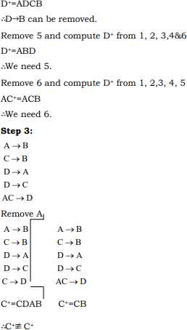

Slide 38
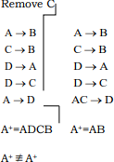

Slide 39
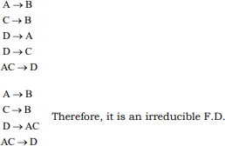

Slide 40
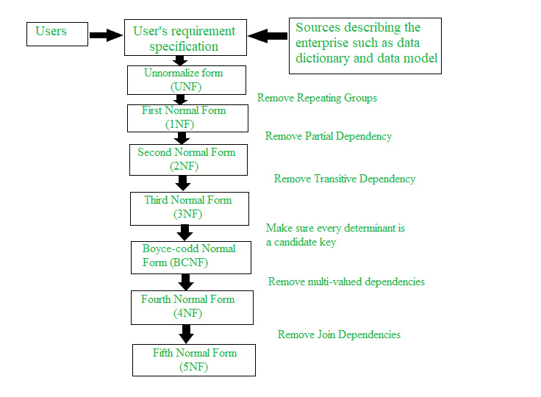
Normalization Process
Database Normalization is a stepwise formal process that allows us to decompose database tables in such a way that both data dependency and update anomalies are minimized. It makes use of functional dependency that exists in the table and the primary key or candidate key in analyzing the tables.

Slide 41
Normal Form | Description
1NF | A relation is in 1NF if it contains an atomic value.
2NF | A relation will be in 2NF if it is in 1NF and all non-key attributes are fully functional dependent on the primary key.
3NF | A relation will be in 3NF if it is in 2NF and no transition dependency exists.
BCNF | A stronger definition of 3NF is known as Boyce Codd's normal form.
4NF | A relation will be in 4NF if it is in Boyce Codd's normal form and has no multi-valued dependency.
5NF | A relation is in 5NF. If it is in 4NF and does not contain any join dependency, joining should be lossless.

Slide 42
What is Normalization?
Normalization is the process of organizing the data in the database.
Normalization is used to minimize the redundancy from a relation or set of relations. It is also used to eliminate undesirable characteristics like Insertion, Update, and Deletion Anomalies.
Normalization divides the larger table into smaller and links them using relationships.
The normal form is used to reduce redundancy from the database table.

Slide 43
First Normal Form (1NF):
A relation will be 1NF if it contains an atomic value.
It states that an attribute of a table cannot hold multiple values. It must hold only single-valued attribute.
First normal form disallows the multi-valued attribute, composite attribute, and their combinations.

Slide 44
Relation EMPLOYEE is not in 1NF because of multi-valued attribute EMP_PHONE.
EMPLOYEE table:
EMP_ID | EMP_NAME | EMP_PHONE | EMP_STATE
14 | John | 7272826385, 9064738238 | UP
20 | Harry | 8574783832 | Bihar
12 | Sam | 7390372389, 8589830302 | Punjab

Slide 45
The decomposition of the EMPLOYEE table into 1NF has been shown below:
EMP_ID | EMP_NAME | EMP_PHONE | EMP_STATE
14 | John | 7272826385 | UP
14 | John | 9064738238 | UP
20 | Harry | 8574783832 | Bihar
12 | Sam | 7390372389 | Punjab
12 | Sam | 8589830302 | Punjab

Slide 46
Second Normal Form (2NF)
In the 2NF, relational must be in 1NF.
In the second normal form, all non-key attributes are fully functional dependent on the primary key
In a school, a teacher can teach more than one subject.
In the given table, non-prime attribute TEACHER_AGE is dependent on TEACHER_ID which is a proper subset of a candidate key. That's why it violates the rule for 2NF.
TEACHER table
TEACHER_ID | SUBJECT | TEACHER_AGE
25 | Chemistry | 30
25 | Biology | 30
47 | English | 35
83 | Math | 38
83 | Computer | 38

Slide 47
TEACHER_DETAIL table:
TEACHER_SUBJECT table:
TEACHER_ID | TEACHER_AGE
25 | 30
47 | 35
83 | 38
TEACHER_ID | SUBJECT
25 | Chemistry
25 | Biology
47 | English
83 | Math
83 | Computer

Slide 48
Third Normal Form (3NF)
A relation will be in 3NF if it is in 2NF and not contain any transitive partial dependency.
3NF is used to reduce the data duplication. It is also used to achieve the data integrity.
If there is no transitive dependency for non-prime attributes, then the relation must be in third normal form.
A relation is in third normal form if it holds atleast one of the following conditions for every non-trivial function dependency X → Y.
X is a super key.
Y is a prime attribute, i.e., each element of Y is part of some candidate key.
3NF in DBMS | Third Normal Form - javatpoint

Slide 49
EMPLOYEE_DETAIL table:
EMP_ID | EMP_NAME | EMP_ZIP | EMP_STATE | EMP_CITY
222 | Harry | 201010 | UP | Noida
333 | Stephan | 02228 | US | Boston
444 | Lan | 60007 | US | Chicago
555 | Katharine | 06389 | UK | Norwich
666 | John | 462007 | MP | Bhopal
Here, EMP_STATE & EMP_CITY dependent on EMP_ZIP and EMP_ZIP dependent on EMP_ID. The non-prime attributes (EMP_STATE, EMP_CITY) transitively dependent on super key(EMP_ID). It violates the rule of third normal form.
Super key in the table above:
{EMP_ID}, {EMP_ID, EMP_NAME}, {EMP_ID, EMP_NAME, EMP_ZIP}....so on
Candidate key: {EMP_ID}
Non-prime attributes: In the given table, all attributes except EMP_ID are non-prime.

Slide 50
EMPLOYEE table:
EMP_ID | EMP_NAME | EMP_ZIP
222 | Harry | 201010
333 | Stephan | 02228
444 | Lan | 60007
555 | Katharine | 06389
666 | John | 462007
EMPLOYEE_ZIP table:
EMP_ZIP | EMP_STATE | EMP_CITY
201010 | UP | Noida
02228 | US | Boston
60007 | US | Chicago
06389 | UK | Norwich
462007 | MP | Bhopal

Slide 51
Boyce Codd normal form (BCNF)
BCNF is the advance version of 3NF. It is stricter than 3NF.
A table is in BCNF if every functional dependency X → Y, X is the super key of the table.
For BCNF, the table should be in 3NF, and for every FD, LHS is super key
EMPLOYEE table:
In the table Functional dependencies are as follows:
EMP_ID → EMP_COUNTRY
EMP_DEPT → {DEPT_TYPE, EMP_DEPT_NO}
EMP_ID | EMP_COUNTRY | EMP_DEPT | DEPT_TYPE | EMP_DEPT_NO
264 | India | Designing | D394 | 283
264 | India | Testing | D394 | 300
364 | UK | Stores | D283 | 232
364 | UK | Developing | D283 | 549
Candidate key: {EMP-ID, EMP-DEPT}

Slide 52
The table is not in BCNF because neither EMP_DEPT nor EMP_ID alone are keys.
To convert the given table into BCNF, we decompose it into three tables:
EMP_ID | EMP_DEPT
D394 | 283
D394 | 300
D283 | 232
D283 | 549
EMP_ID | EMP_COUNTRY
264 | India
264 | India
Functional dependencies:
EMP_ID → EMP_COUNTRY
EMP_DEPT → {DEPT_TYPE, EMP_DEPT_NO}
Candidate keys:
For the first table: EMP_ID
For the second table: EMP_DEPT
For the third table: {EMP_ID, EMP_DEPT}
EMP_DEPT | DEPT_TYPE | EMP_DEPT_NO
Designing | D394 | 283
Testing | D394 | 300
Stores | D283 | 232
Developing | D283 | 549

Slide 53
Fourth normal form (4NF)
A relation will be in 4NF if it is in Boyce Codd normal form and has no multi-valued dependency.
For a dependency A → B, if for a single value of A, multiple values of B exists, then the relation will be a multi-valued dependency.
STUDENT
The given STUDENT table is in 3NF, but the COURSE and HOBBY are two independent entity. Hence, there is no relationship between COURSE and HOBBY.
In the STUDENT relation, a student with STU_ID, 21 contains two courses, Computer and Math and two hobbies, Dancing and Singing. So there is a Multi-valued dependency on STU_ID, which leads to unnecessary repetition of data.
STU_ID | COURSE | HOBBY
21 | Computer | Dancing
21 | Math | Singing
34 | Chemistry | Dancing
74 | Biology | Cricket
59 | Physics | Hockey

Slide 54
STUDENT_HOBBY
STU_ID | HOBBY
21 | Dancing
21 | Singing
34 | Dancing
74 | Cricket
59 | Hockey
STUDENT_COURSE
STU_ID | COURSE
21 | Computer
21 | Math
34 | Chemistry
74 | Biology
59 | Physics

Slide 55
Fifth normal form (5NF)
A relation is in 5NF if it is in 4NF and not contains any join dependency and joining should be lossless.
5NF is satisfied when all the tables are broken into as many tables as possible in order to avoid redundancy.
5NF is also known as Project-join normal form (PJ/NF).
SUBJECT | LECTURER | SEMESTER
Computer | Anshika | Semester 1
Computer | John | Semester 1
Math | John | Semester 1
Math | Akash | Semester 2
Chemistry | Praveen | Semester 1
In the above table, John takes both Computer and Math class for Semester 1 but he doesn't take Math class for Semester 2. In this case, combination of all these fields required to identify a valid data.

Slide 56
Suppose we add a new Semester as Semester 3 but do not know about the subject and who will be taking that subject so we leave Lecturer and Subject as NULL. But all three columns together acts as a primary key, so we can't leave other two columns blank.
So to make the above table into 5NF, we can decompose it into three relations P1, P2 & P3:
SEMESTER | SUBJECT
Semester 1 | Computer
Semester 1 | Math
Semester 1 | Chemistry
Semester 2 | Math
SUBJECT | LECTURER
Computer | Anshika
Computer | John
Math | John
Math | Akash
Chemistry | Praveen
SEMSTER | LECTURER
Semester 1 | Anshika
Semester 1 | John
Semester 1 | John
Semester 2 | Akash
Semester 1 | Praveen

Slide 57
You can also consider that a relation is in 5NF, if the candidate key implies every join dependency in it.
Decomposition is lossless-join decomposition if it preserves all the data in original relation and does not result in additional tuples.
A relation R satisfies join dependency iff R is equal to the join of R1,R2,.....Rn where Ri are a subset of the set of attributes of R.

Slide 58
Relation R
Dept | Subject | Name
CSE | C | Alok
CSE | C | Amar
CSE | Java | Amar
IT | C | Asit
Here,
dept ->-> subject
dept->-> name
The above relation says that dept offers many elective subjects which are taken by a variety of students. Students have the opinion to choose subjects.
Therefore, all three fields are needed to represent the information.
Composite key(dept, subject, Name)

Slide 59
R1
R2
Dept | Subject
CSE | C
CSE | Java
IT | C
Dept | Name
CSE | Alok
CSE | Amar
IT | Asit
R3
Subject | Name
C | Alok
C | Amar
Java | Amar
C | Asit

Slide 60
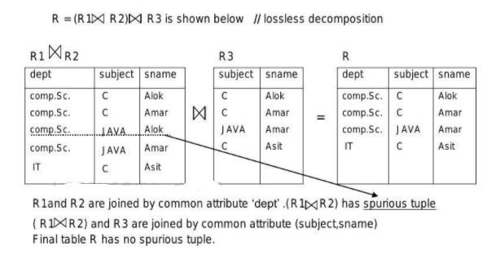

Slide 61
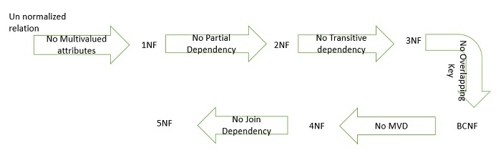

Slide 62
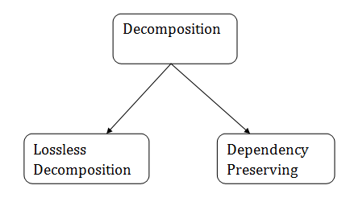
Relational Decomposition
When a relation in the relational model is not in appropriate normal form then the decomposition of a relation is required.
In a database, it breaks the table into multiple tables.
If the relation has no proper decomposition, then it may lead to problems like loss of information.
Decomposition is used to eliminate some of the problems of bad design like anomalies, inconsistencies, and redundancy.

Slide 63
Lossless Decomposition
If the information is not lost from the relation that is decomposed, then the decomposition will be lossless.
The lossless decomposition guarantees that the join of relations will result in the same relation as it was decomposed.
The relation is said to be lossless decomposition if natural joins of all the decomposition give the original relation.
R1 UNION R2 SHOULD BE EQUAL TO R
R1 INTERSECTION R1 SHOULD BE NULL
THE COMMON ATTRIBUTE OF DECOMPOSED TABLES SHOULD BE A CANDIDATE KEY OR SUPER KEY OF EITHER ONE OF THE TABLES OR BOTH.

Slide 64
Dependency Preserving
It is an important constraint of the database.
In the dependency preservation, at least one decomposed table must satisfy every dependency.
If a relation R is decomposed into relation R1 and R2, then the dependencies of R either must be a part of R1 or R2 or must be derivable from the combination of functional dependencies of R1 and R2.
For example, suppose there is a relation R (A, B, C, D) with functional dependency set (A->BC). The relational R is decomposed into R1(ABC) and R2(AD) which is dependency preserving because FD A->BC is a part of relation R1(ABC).

Slide 65
THANK YOU

